Slide 1
Text Generation
Recommendation
GenerativeAI
Machine
Language
Image generation
Fraud Detection
Artificial
Intelligence
Code Generation
Price Predictions
Pay up ML Models
Data Enrichment →
Feature Simplification,
Imputer, Scaler,Encoder
Classification →
Missingness Detection,
XGBoost Classifier
Deep Learning
Regression →
Price Prediction,
XGBoost Regressor
Autonomous driving
Face Recognition
Unsupervised Learning →
Outlier Detection,
Isolation Forest

Slide 2
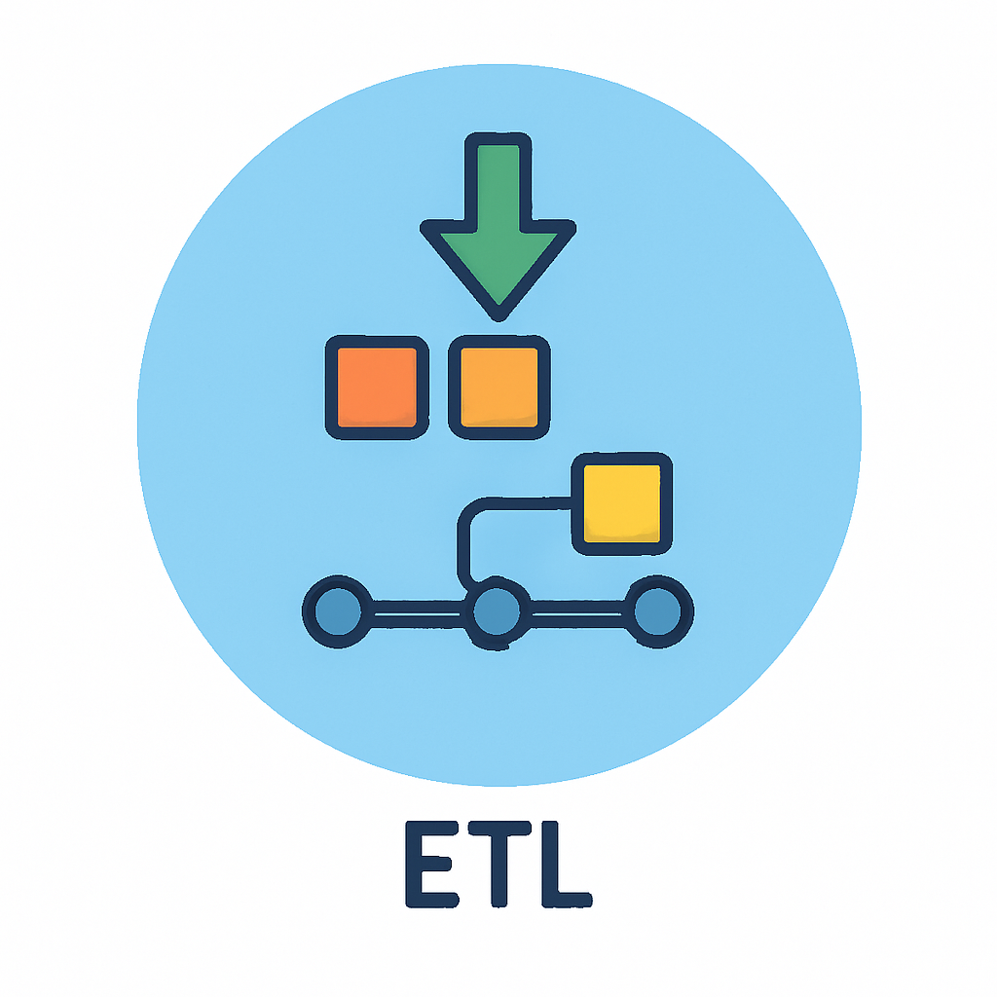








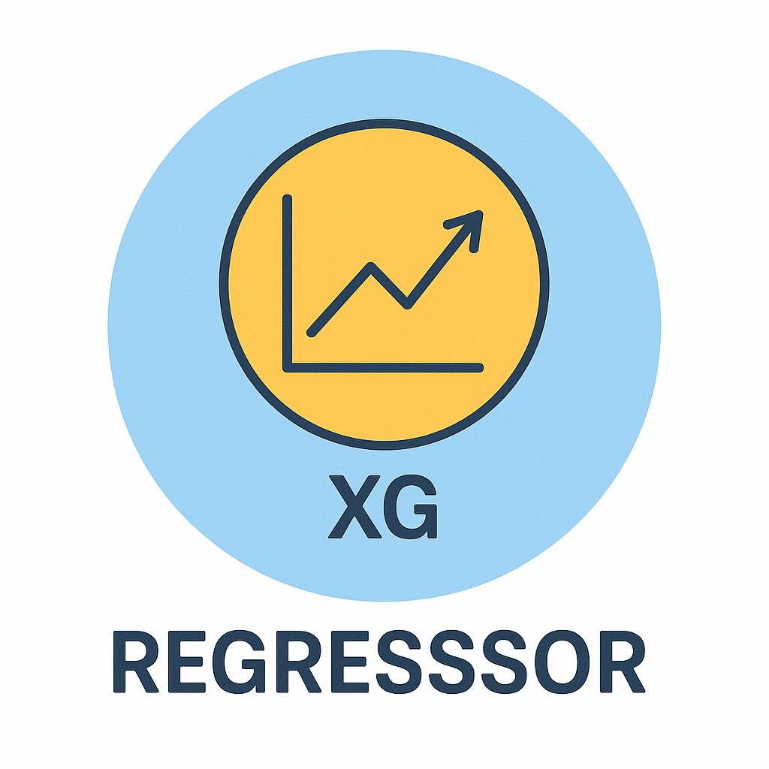


Training
Inference
Pay up Model
New Pay up

